Slide 1

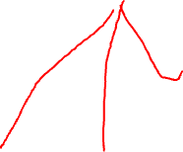
Statistical & Mathematical Methods for Data Science
By
Dr Rafiullah Khan

Slide 2
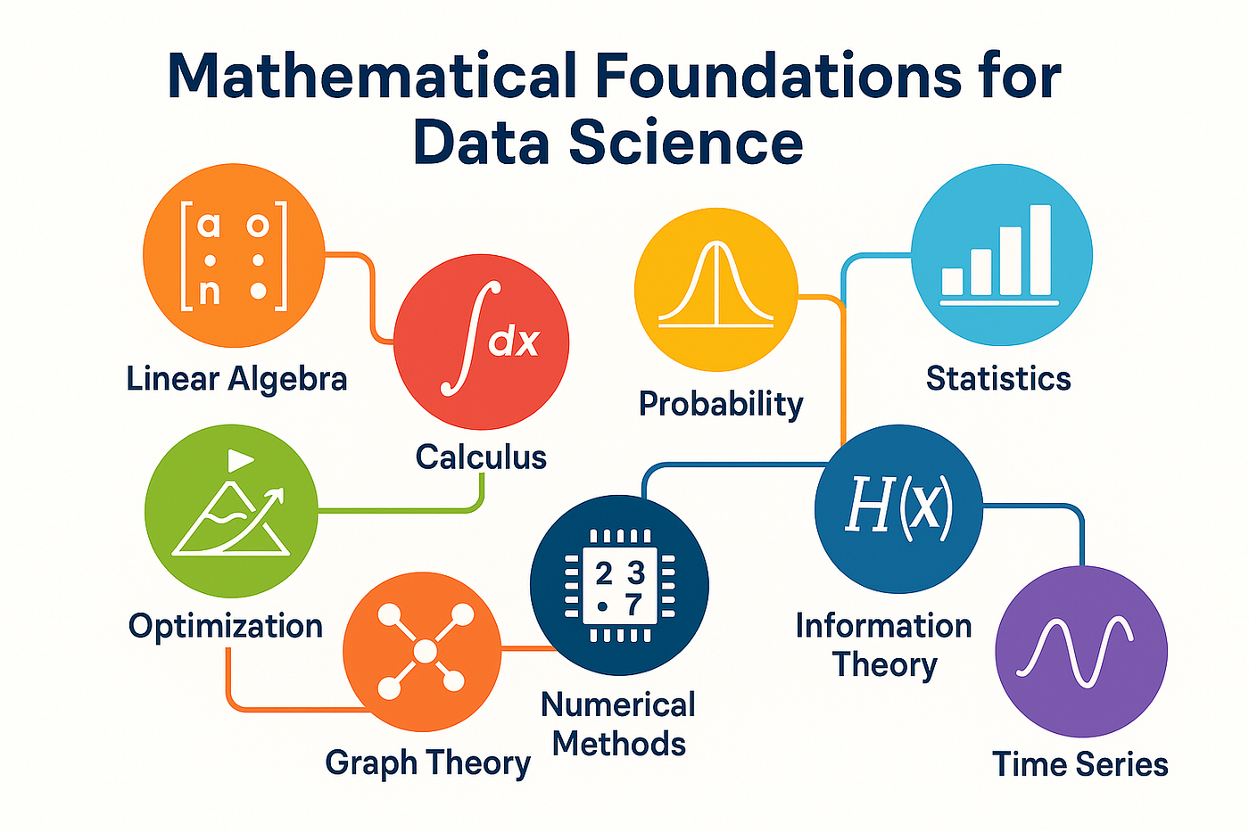
Week 2 Mathematical Foundations for Data Science

Slide 3
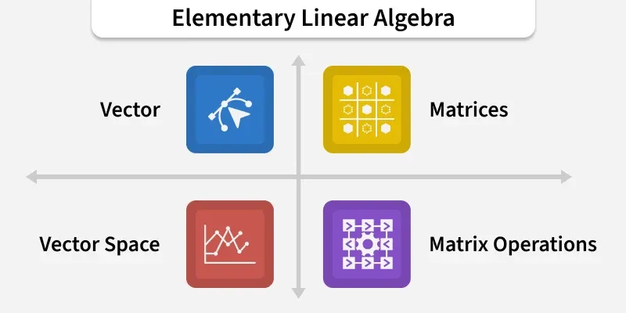
Linear Algebra

Slide 4
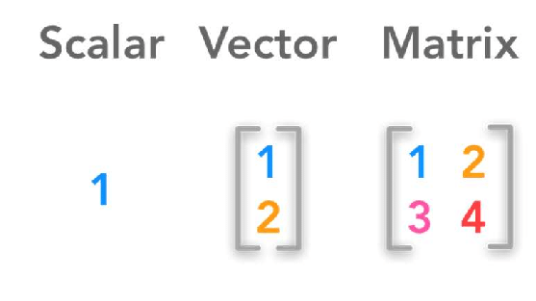
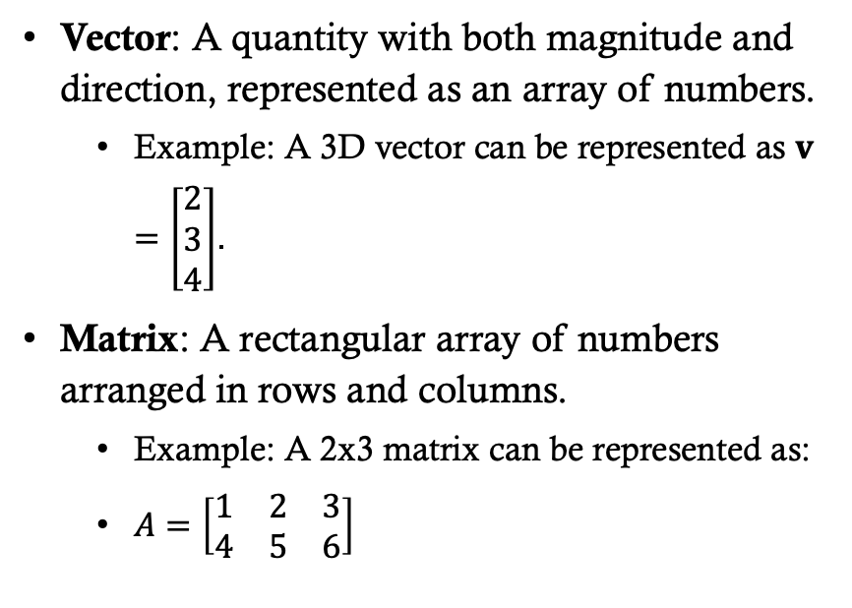
Vectors and Matrices
Vector: A quantity with both magnitude and direction, represented as an array of numbers.
Example: A 3D vector can be represented as $v=\left[\begin{matrix}2 \\ 3 \\ 4\end{matrix}\right]$.
Matrix: A rectangular array of numbers arranged in rows and columns.
Example: A 2x3 matrix can be represented as:
$A=\left[\begin{matrix}1 & 2 & 3 \\ 4 & 5 & 6\end{matrix}\right]$

Slide 5
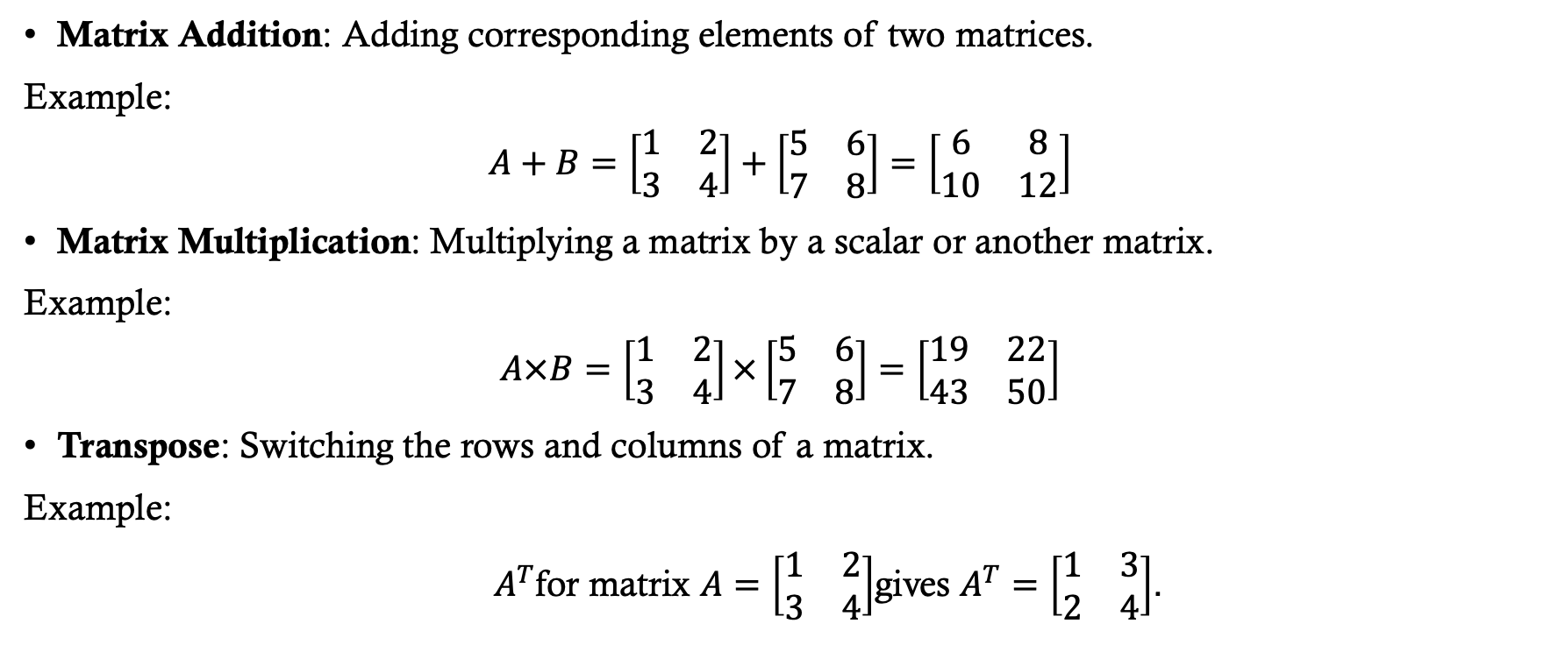
Matrix Operations
Matrix Addition: Adding corresponding elements of two matrices.
Example:
$$A+B=\left[\begin{matrix}1 & 2 \\ 3 & 4\end{matrix}\right]+\left[\begin{matrix}5 & 6 \\ 7 & 8\end{matrix}\right]=\left[\begin{matrix}6 & 8 \\ 10 & 12\end{matrix}\right]$$
Matrix Multiplication: Multiplying a matrix by a scalar or another matrix.
Example:
$$A×B=\left[\begin{matrix}1 & 2 \\ 3 & 4\end{matrix}\right]×\left[\begin{matrix}5 & 6 \\ 7 & 8\end{matrix}\right]=\left[\begin{matrix}19 & 22 \\ 43 & 50\end{matrix}\right]$$
Transpose: Switching the rows and columns of a matrix.
Example:
$A^{T}$for matrix $A=\left[\begin{matrix}1 & 2 \\ 3 & 4\end{matrix}\right]$gives $A^{T}=\left[\begin{matrix}1 & 3 \\ 2 & 4\end{matrix}\right]$.

Slide 6
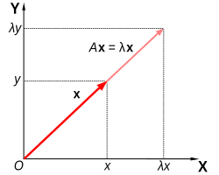
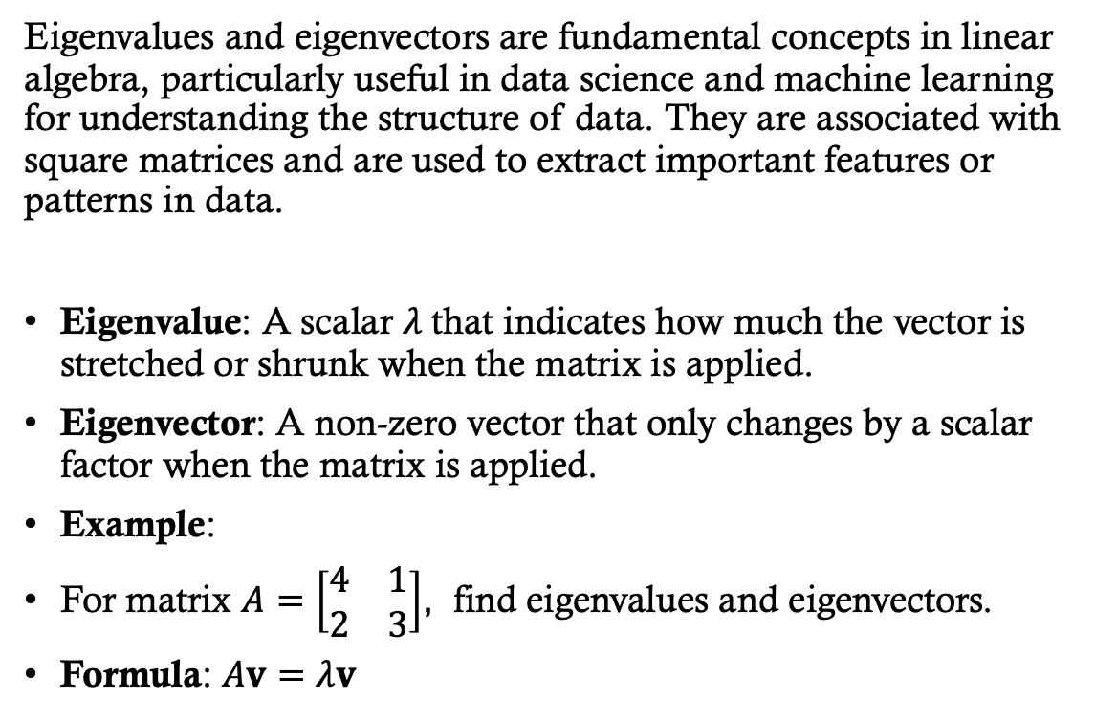
Eigenvalues and Eigenvectors
Eigenvalues and eigenvectors are fundamental concepts in linear algebra, particularly useful in data science and machine learning for understanding the structure of data. They are associated with square matrices and are used to extract important features or patterns in data.
Eigenvalue: A scalar $λ$that indicates how much the vector is stretched or shrunk when the matrix is applied.
Eigenvector: A non-zero vector that only changes by a scalar factor when the matrix is applied.
Example:
For matrix $A=\left[\begin{matrix}4 & 1 \\ 2 & 3\end{matrix}\right]$, find eigenvalues and eigenvectors.
Formula: $Av=λv$

Slide 7

Why Do We Use Eigenvalues and Eigenvectors in Data Science?
Principal Component Analysis (PCA): PCA is a technique used for dimensionality reduction, and it relies heavily on eigenvalues and eigenvectors. In PCA, the data matrix is decomposed, and the eigenvectors of the covariance matrix represent the directions (or axes) in which the data has the most variance. The eigenvalues correspond to the amount of variance along these axes.
By selecting the eigenvectors with the largest eigenvalues, you can reduce the data's dimensionality while retaining the most important features.
Feature Extraction: Eigenvectors help identify the most significant features of the data, especially in high-dimensional spaces. For example, in image processing or text mining, eigenvectors can be used to identify dominant patterns, such as edges in images or common themes in text.
Understanding Data Structure: Eigenvalues provide insight into the strength or significance of various dimensions in the data. In machine learning, these values can help you understand the intrinsic structure of the data and focus on the most relevant dimensions.
Covariance Matrix and Data Variance: In statistics, the covariance matrix helps measure how the features in the data are related. The eigenvectors of the covariance matrix represent the directions of maximum variance in the data, while the eigenvalues quantify the strength of this variance. This is particularly useful when analyzing correlations between features in datasets.
Graph Analysis and Spectral Clustering: Eigenvectors are used in graph theory, particularly in spectral clustering. The eigenvectors of the Laplacian matrix of a graph represent clusters in the data, allowing for the identification of communities or groups in large networks.
Stability Analysis and Optimization: In optimization problems, eigenvalues help in assessing the stability of a system. Positive or negative eigenvalues can indicate whether an equilibrium point is stable or unstable. This concept is used in optimization algorithms and models, such as in gradient-based optimization.
Data Compression: Eigenvalue decomposition is used in algorithms for compressing large datasets, especially in image compression, where the key components are captured by the largest eigenvectors, and the rest can be discarded.

Slide 8
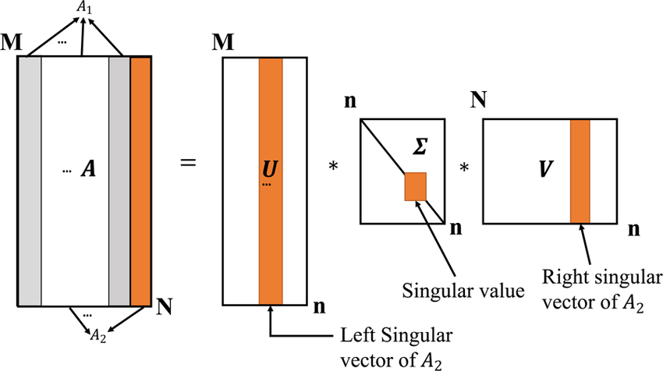
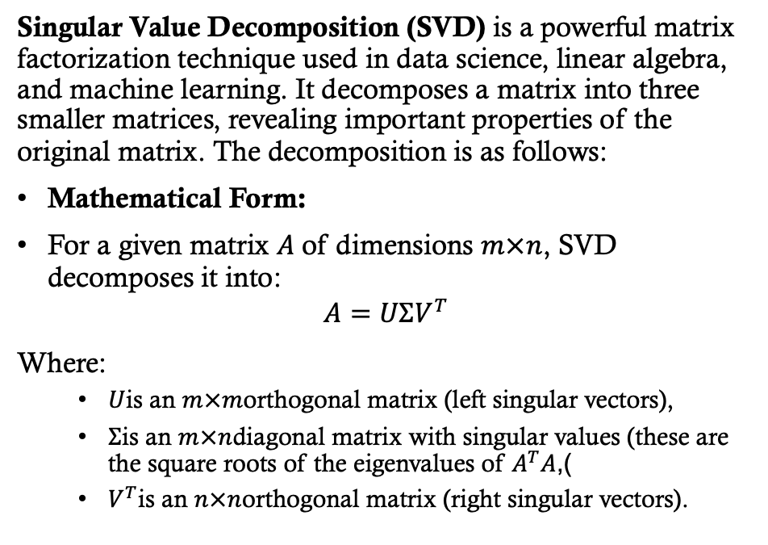

Singular Value Decomposition (SVD)
Singular Value Decomposition (SVD) is a powerful matrix factorization technique used in data science, linear algebra, and machine learning. It decomposes a matrix into three smaller matrices, revealing important properties of the original matrix. The decomposition is as follows:
Mathematical Form:
For a given matrix $A$of dimensions $m×n$, SVD decomposes it into:
$$A=UΣV^{T}$$
Where:
$U$is an $m×m$orthogonal matrix (left singular vectors),
$Σ$is an $m×n$diagonal matrix with singular values (these are the square roots of the eigenvalues of $A^{T}A$),
$V^{T}$is an $n×n$orthogonal matrix (right singular vectors).

Slide 9

Why do we use SVD in Data Science?
Dimensionality Reduction:
SVD is commonly used in Principal Component Analysis (PCA) for dimensionality reduction. By retaining the largest singular values and their corresponding vectors, we can reduce the number of features in the dataset while retaining most of the variance or information.
Noise Reduction:
In datasets with noise or irrelevant information, SVD helps isolate the most significant components, thus enhancing the signal-to-noise ratio and improving model performance.
Data Compression:
SVD is used in image compression. The singular values represent the most important information in the image, and by approximating the image with fewer singular values, we can achieve compression without significant loss of quality.
Recommender Systems:
In collaborative filtering (used in recommender systems like Netflix, Amazon), SVD can be used to factorize the user-item matrix. This helps identify latent factors that explain user preferences and make recommendations.
Feature Extraction:
SVD can be used to identify important features (latent variables) in high-dimensional datasets. This can help build more efficient models by reducing redundant or less informative features.
Matrix Approximation:
By approximating the matrix with only the most significant singular values, SVD can be used to find low-rank approximations, which is helpful in situations like predicting missing values in datasets or solving ill-posed problems.

Slide 10
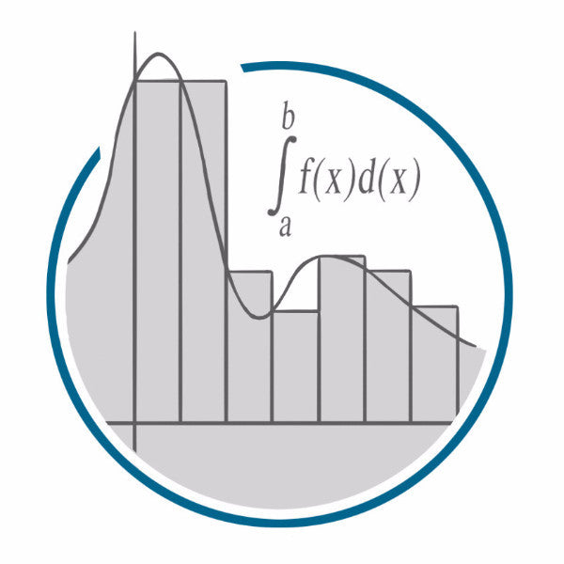
Calculus

Slide 11
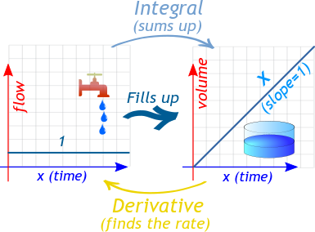

Limits, Derivatives, and Integrals
Limits, derivatives, and integrals are fundamental concepts in calculus that play an essential role in many areas of data science, machine learning, and optimization. These concepts help us understand and model changes, trends, and accumulated quantities, which are crucial for making predictions, analyzing patterns, and improving model performance.

Slide 12
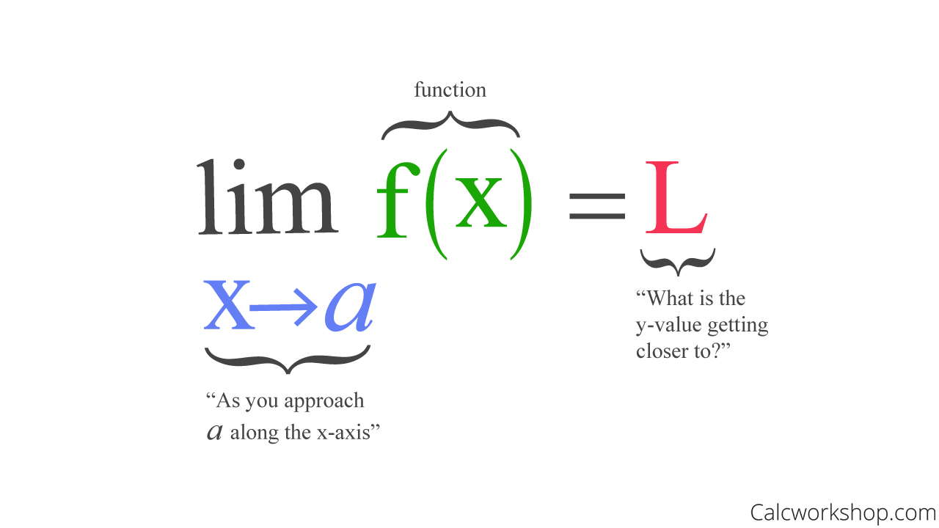
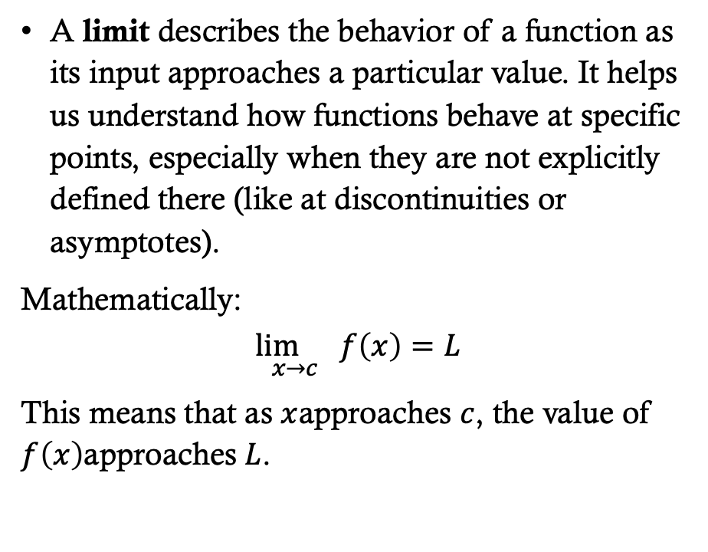

Limits
A limit describes the behavior of a function as its input approaches a particular value. It helps us understand how functions behave at specific points, especially when they are not explicitly defined there (like at discontinuities or asymptotes).
Mathematically:
$$\underset{x→c}{\lim{}}f\left(x\right)=L$$
This means that as $x$approaches $c$, the value of $f\left(x\right)$approaches $L$.

Slide 13

Usage of LIMITS in Data Science
Optimization: Limits are crucial in optimization algorithms, especially when the goal is to find the local minimum or maximum of a function. For example, in gradient descent, the limit is approached as we iteratively minimize the error or loss function.
Convergence: In machine learning, limits are used to analyze the convergence of algorithms. For instance, as the number of iterations increases in an algorithm like gradient descent, the weight updates approach the optimal values.
Model Stability: Limits help in understanding the stability of certain models as they approach boundary conditions, such as the behavior of functions when inputs get very large or very small.

Slide 14
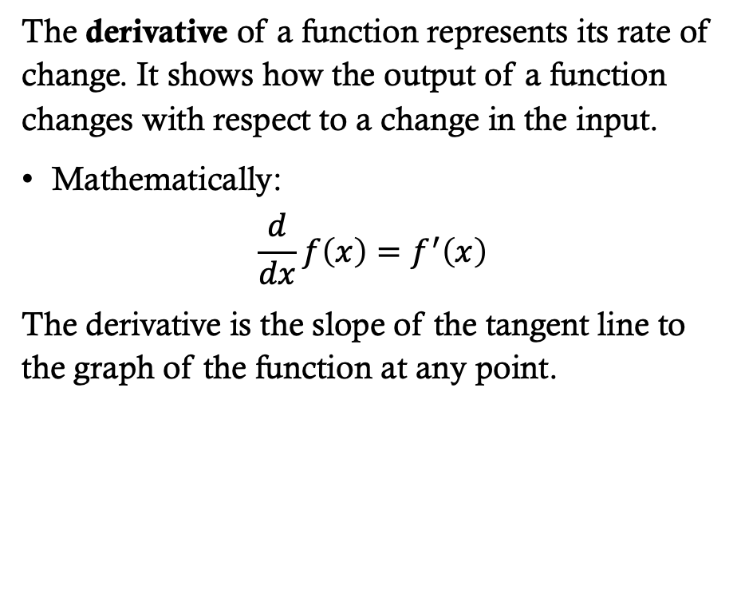
Derivatives
The derivative of a function represents its rate of change. It shows how the output of a function changes with respect to a change in the input.
Mathematically:
$$\frac{d}{dx}f\left(x\right)=f^{′}\left(x\right)$$
The derivative is the slope of the tangent line to the graph of the function at any point.

Slide 15
Usage of Derivatives in Data Science:
Gradient Descent: Derivatives are crucial in optimization algorithms like gradient descent, which is used to minimize a loss function. The derivative gives the gradient, or the direction in which the function increases or decreases the most. By updating parameters in the opposite direction of the gradient, we minimize the function and improve the model.
Model Tuning: In machine learning, derivatives are used to tune model parameters, such as weights in neural networks, to optimize performance. The optimization process involves taking derivatives to minimize the loss function.
Sensitivity Analysis: Derivatives are used in sensitivity analysis to measure how small changes in input variables affect the output. For example, in regression, derivatives help measure how sensitive the dependent variable is to changes in each feature.
Feature Importance: In certain machine learning models (e.g., decision trees, random forests), derivatives can help assess the importance of features by examining how changes in features impact model predictions.

Slide 16
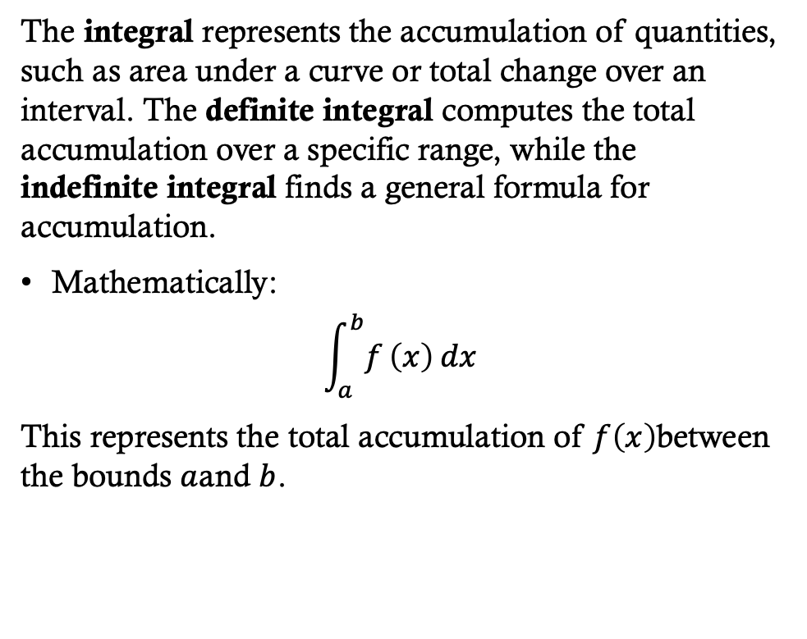
Integrals
The integral represents the accumulation of quantities, such as area under a curve or total change over an interval. The definite integral computes the total accumulation over a specific range, while the indefinite integral finds a general formula for accumulation.
Mathematically:
$$\int_{a}^{b}{f}\left(x\right) dx$$
This represents the total accumulation of $f\left(x\right)$between the bounds $a$and $b$.

Slide 17
Usage of integrals in Data Science:
Area Under Curves: In machine learning, integrals are used to calculate the area under the ROC curve (AUC) in classification problems. AUC helps evaluate the performance of a model by measuring the tradeoff between true positive rate and false positive rate.
Probability Distribution: In probability theory, the integral of a probability density function (PDF) over a given range gives the probability of the random variable falling within that range. Integrals are essential in models like Gaussian Mixture Models (GMM), where they are used to compute probabilities.
Cumulative Sums: In some time-series analysis, integrals can be used to accumulate information over time, such as in modeling the total growth of a quantity (e.g., total sales or total traffic).
Data Smoothing and Accumulation: In signal processing and other data analysis techniques, integrals help in smoothing data or finding cumulative quantities over time, such as cumulative profit, costs, or losses.

Slide 18
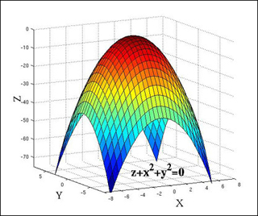
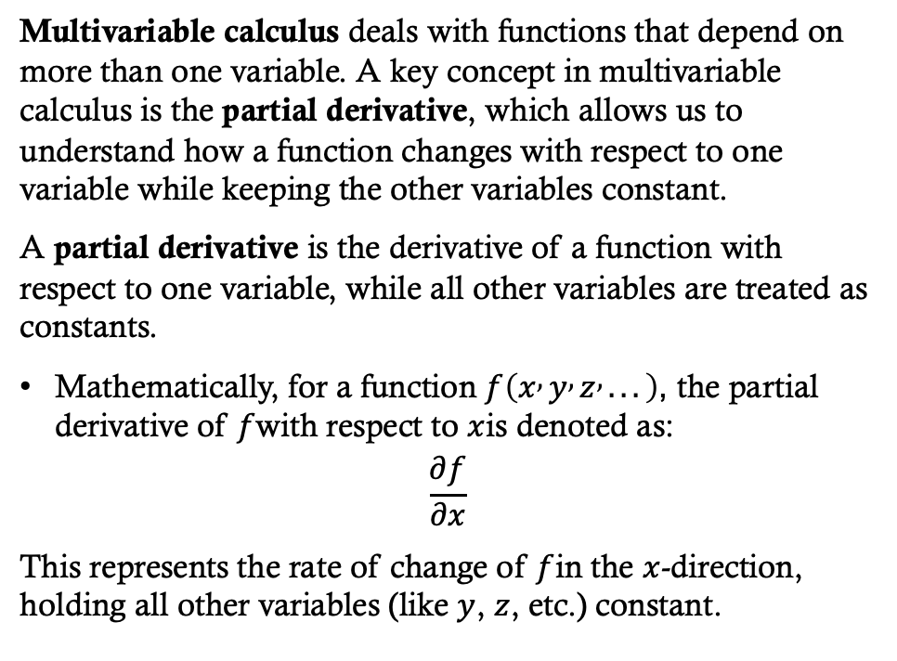
Multivariable Calculus (Partial Derivatives)
Multivariable calculus deals with functions that depend on more than one variable. A key concept in multivariable calculus is the partial derivative, which allows us to understand how a function changes with respect to one variable while keeping the other variables constant.
A partial derivative is the derivative of a function with respect to one variable, while all other variables are treated as constants.
Mathematically, for a function $f\left(x , y , z , ...\right)$, the partial derivative of $f$with respect to $x$is denoted as:
$$\frac{∂f}{∂x}$$
This represents the rate of change of $f$in the $x$-direction, holding all other variables (like $y$, $z$, etc.) constant.

Slide 19
Uses of Partial Derivatives in Data Science
Optimization (Gradient Descent): Partial derivatives are fundamental to optimization algorithms like gradient descent, which is widely used in machine learning for training models (e.g., linear regression, neural networks).
Backpropagation in Neural Networks: In training deep learning models, backpropagation is a method used to update the weights of the network. During backpropagation, partial derivatives of the error (loss) function are computed with respect to each weight in the network using the chain rule.
Multiple Parameters: Many machine learning algorithms involve multiple parameters (e.g., weights and biases in neural networks, regularization coefficients in regularized regression). The partial derivatives are used to optimize these parameters.
Sensitivity Analysis: Partial derivatives are used to perform sensitivity analysis, which helps assess how sensitive the output of a model is to changes in each individual feature or input variable.
Logistic Regression: In logistic regression, the goal is to minimize a cost function (e.g., cross-entropy loss) using gradient-based optimization techniques.
Dimensionality Reduction: Partial derivatives are used in algorithms like Principal Component Analysis (PCA) to find the principal components (the directions of maximum variance) in a high-dimensional dataset.
Multivariate Regression Models: In multivariate regression, where multiple independent variables are used to predict a dependent variable, partial derivatives are used to compute the rate of change of the model’s output with respect to each independent variable.

Slide 20
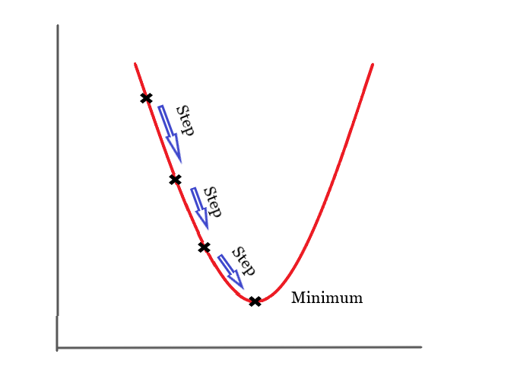
Optimization: Gradient Descent and Its Uses in Data Science
Optimization is the process of adjusting model parameters to minimize or maximize an objective function (e.g., loss function, accuracy). In data science and machine learning, gradient descent is one of the most commonly used optimization algorithms for minimizing a loss function to improve model performance. It helps find the optimal parameters (weights) for machine learning models.

Slide 21

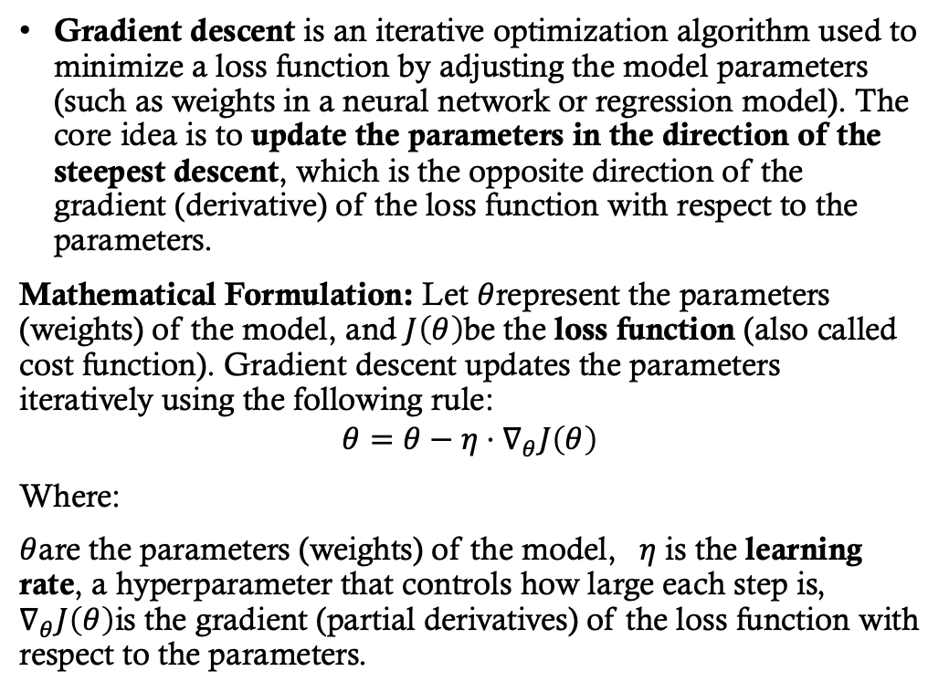
What is Gradient Descent?
Gradient descent is an iterative optimization algorithm used to minimize a loss function by adjusting the model parameters (such as weights in a neural network or regression model). The core idea is to update the parameters in the direction of the steepest descent, which is the opposite direction of the gradient (derivative) of the loss function with respect to the parameters.
Mathematical Formulation: Let $θ$represent the parameters (weights) of the model, and $J\left(θ\right)$be the loss function (also called cost function). Gradient descent updates the parameters iteratively using the following rule:
$$θ=θ−η⋅∇_{θ}J\left(θ\right)$$
Where:
$θ$are the parameters (weights) of the model, $η$ is the learning rate, a hyperparameter that controls how large each step is, $∇_{θ}J\left(θ\right)$is the gradient (partial derivatives) of the loss function with respect to the parameters.

Slide 22
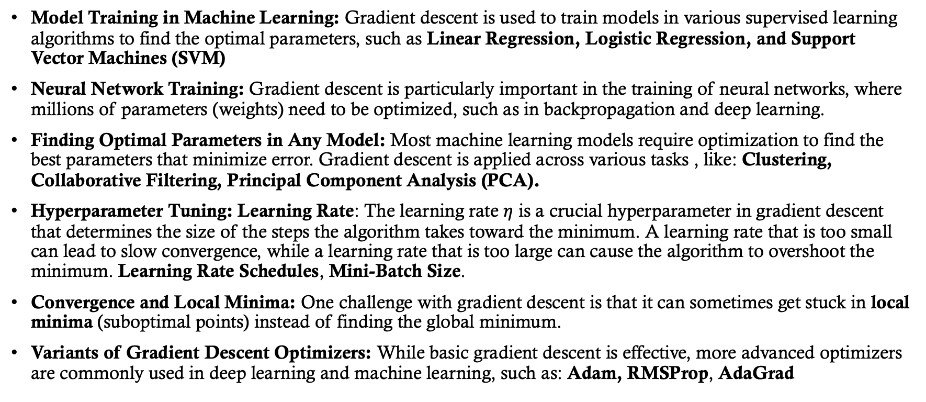
Use Gradient Descent in Data Science
Model Training in Machine Learning: Gradient descent is used to train models in various supervised learning algorithms to find the optimal parameters, such as Linear Regression, Logistic Regression, and Support Vector Machines (SVM)
Neural Network Training: Gradient descent is particularly important in the training of neural networks, where millions of parameters (weights) need to be optimized, such as in backpropagation and deep learning.
Finding Optimal Parameters in Any Model: Most machine learning models require optimization to find the best parameters that minimize error. Gradient descent is applied across various tasks , like: Clustering, Collaborative Filtering, Principal Component Analysis (PCA).
Hyperparameter Tuning: Learning Rate: The learning rate $η$ is a crucial hyperparameter in gradient descent that determines the size of the steps the algorithm takes toward the minimum. A learning rate that is too small can lead to slow convergence, while a learning rate that is too large can cause the algorithm to overshoot the minimum. Learning Rate Schedules, Mini-Batch Size.
Convergence and Local Minima: One challenge with gradient descent is that it can sometimes get stuck in local minima (suboptimal points) instead of finding the global minimum.
Variants of Gradient Descent Optimizers: While basic gradient descent is effective, more advanced optimizers are commonly used in deep learning and machine learning, such as: Adam, RMSProp, AdaGrad

Slide 23
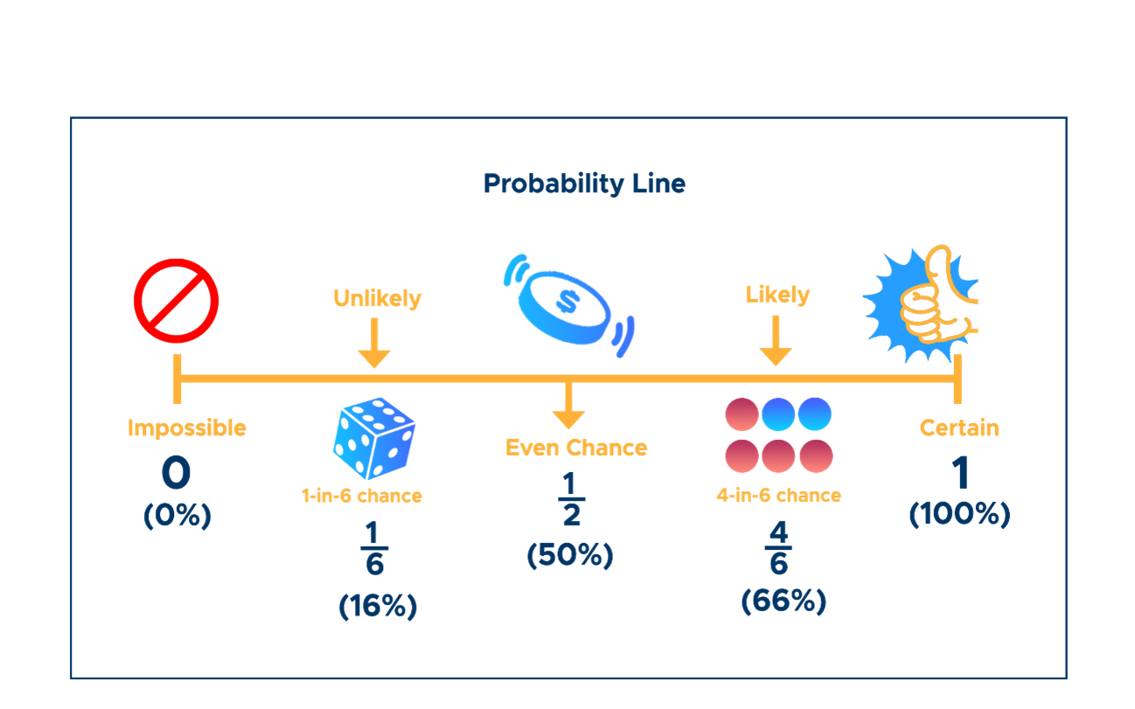
Probability Theory

Slide 24
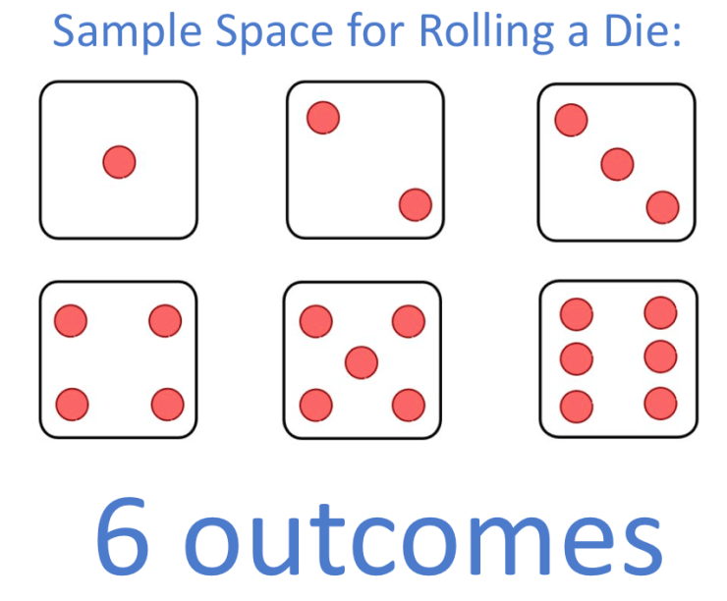
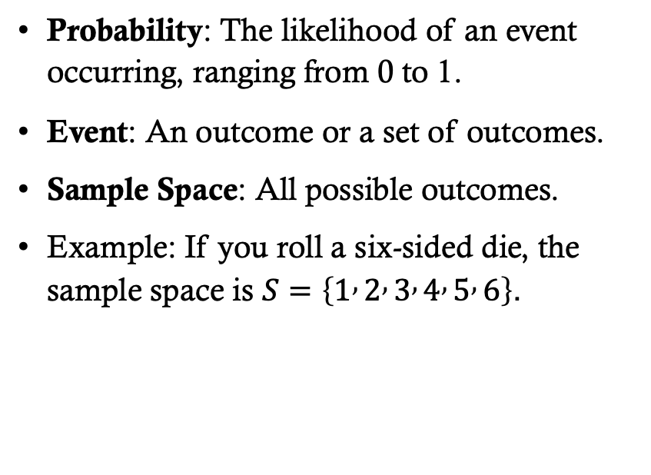
Basic Probability Concepts
Probability: The likelihood of an event occurring, ranging from 0 to 1.
Event: An outcome or a set of outcomes.
Sample Space: All possible outcomes.
Example: If you roll a six-sided die, the sample space is $S=\left\{1 , 2 , 3 , 4 , 5 , 6\right\}$.

Slide 25
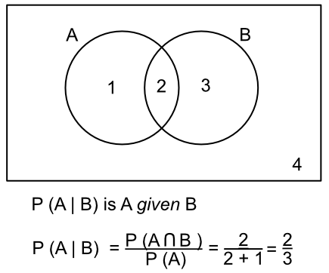
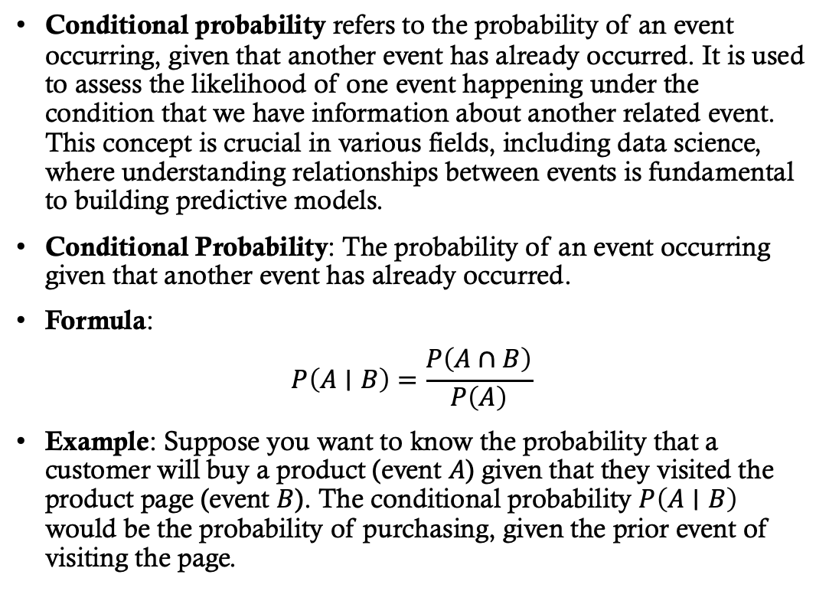
Conditional Probability
Conditional probability refers to the probability of an event occurring, given that another event has already occurred. It is used to assess the likelihood of one event happening under the condition that we have information about another related event. This concept is crucial in various fields, including data science, where understanding relationships between events is fundamental to building predictive models.
Conditional Probability: The probability of an event occurring given that another event has already occurred.
Formula:
$$P\left(A∣B\right)=\frac{P\left(A∩B\right)}{P\left(A\right)}$$
Example: Suppose you want to know the probability that a customer will buy a product (event $A$) given that they visited the product page (event $B$). The conditional probability $P\left(A∣B\right)$ would be the probability of purchasing, given the prior event of visiting the page.

Slide 26
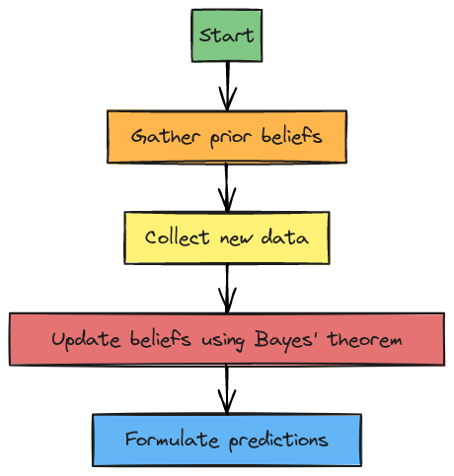
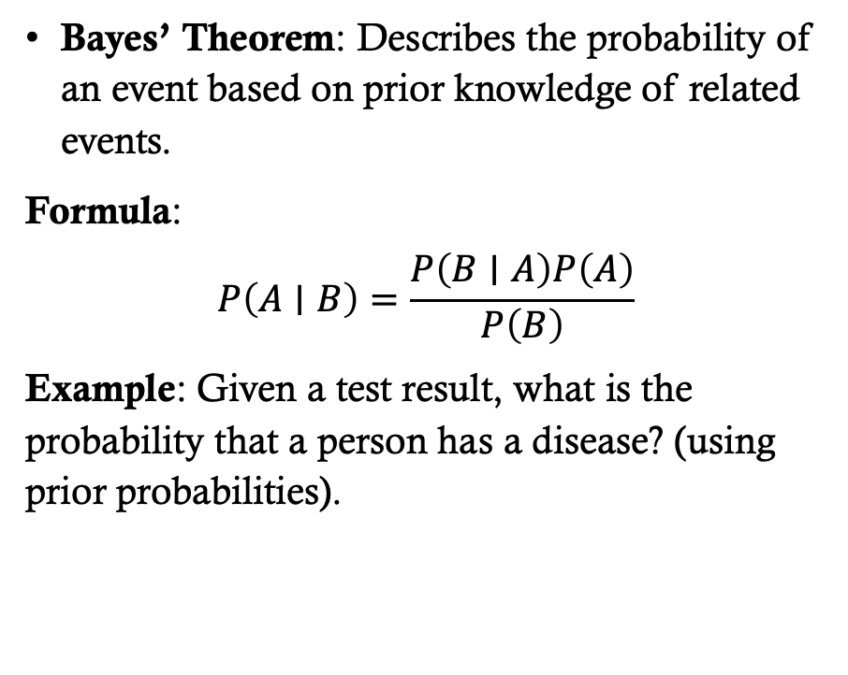
Bayes' Theorem
Bayes’ Theorem: Describes the probability of an event based on prior knowledge of related events.
Formula:
$$P\left(A∣B\right)=\frac{P\left(B∣A\right)P\left(A\right)}{P\left(B\right)}$$
Example: Given a test result, what is the probability that a person has a disease? (using prior probabilities).

Slide 27
Conditional Probability in Data Science
Naive Bayes Classifier (Probabilistic Classification): Naive Bayes is a classification algorithm based on Bayes' Theorem, which uses conditional probability to predict the class of an instance given its features.
Bayesian inference is a statistical technique that uses conditional probability to update the probability of a hypothesis as more data becomes available. In data science, this is used in probabilistic modeling, where prior knowledge is updated with new evidence. For example, in A/B testing, Bayesian inference helps update the probability of success for different treatment groups.
In Decision Trees, conditional probability is used to calculate the likelihood of an event (or class) given a certain condition. This helps in making decisions at each split (node) of the tree.
Hidden Markov Models are used in sequence prediction problems like speech recognition, natural language processing, and time-series analysis.
Probabilistic graphical models (such as Bayesian networks) use conditional probability to model dependencies between variables in a structured way.
Collaborative filtering in recommendation systems uses conditional probability to predict a user's preferences based on the preferences of similar users.
Conditional Probability in Fraud Detection: Conditional probability is used to calculate the likelihood of fraudulent behavior given certain observed actions or transactions.

Slide 28
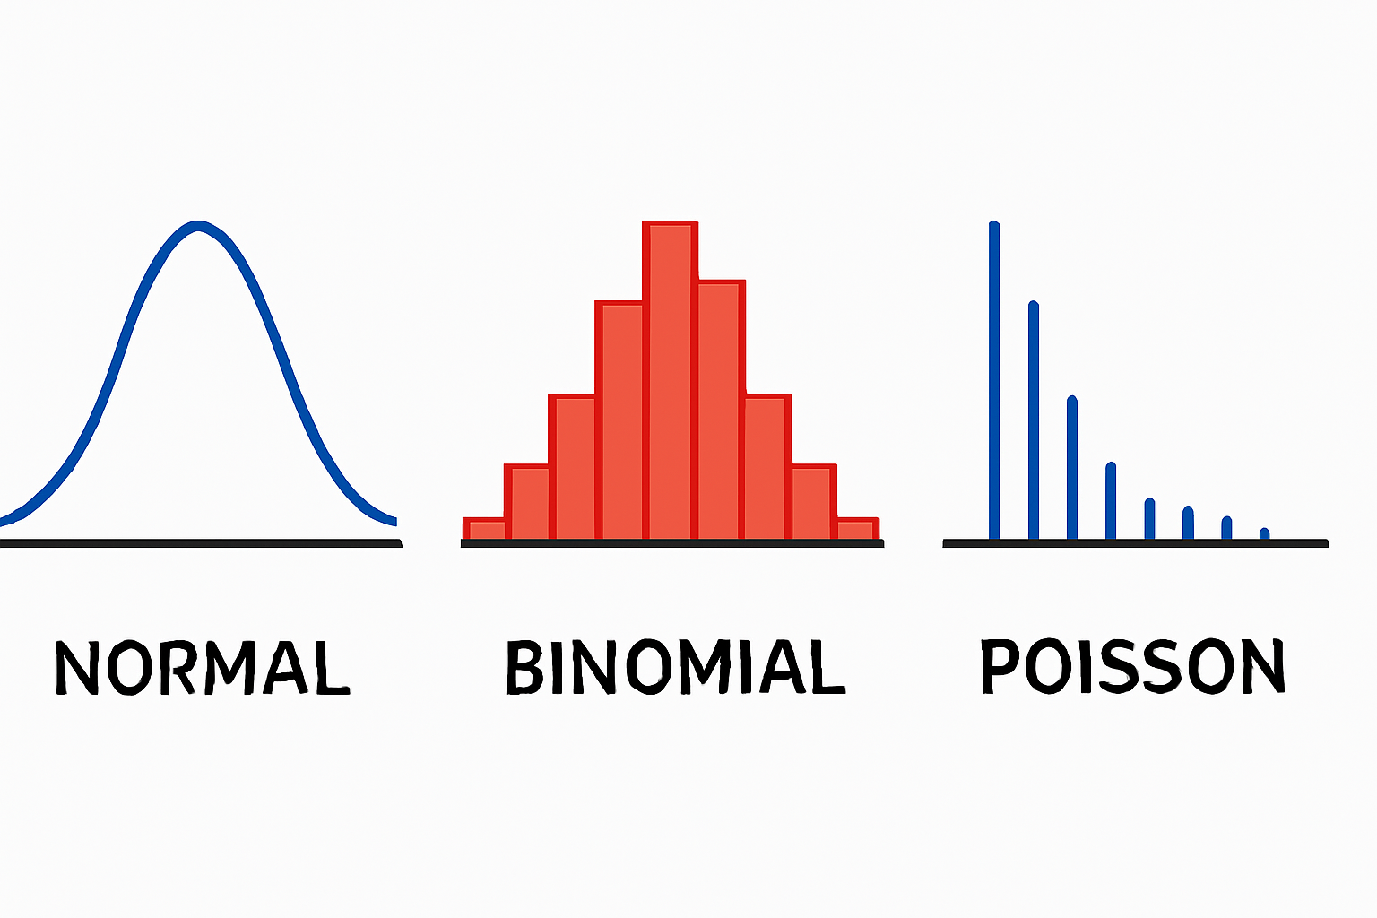
Distributions (Normal, Binomial, Poisson)
In data science, understanding probability distributions is crucial for making informed predictions, modeling uncertainty, and analyzing data effectively. Three of the most commonly used distributions are the Normal Distribution, Binomial Distribution, and Poisson Distribution. Each distribution serves different purposes and is used in a variety of applications depending on the nature of the data and the problem at hand.
Normal Distribution: Symmetrical, bell-shaped curve; mean, median, and mode are equal.
Example: Heights of individuals in a population follow a normal distribution.
Binomial Distribution: Models the number of successes in a fixed number of trials.
Example: The number of heads when flipping a coin 10 times.
Poisson Distribution: Models the number of events occurring in a fixed interval of time.
Example: The number of calls received by a call center in an hour.

Slide 29
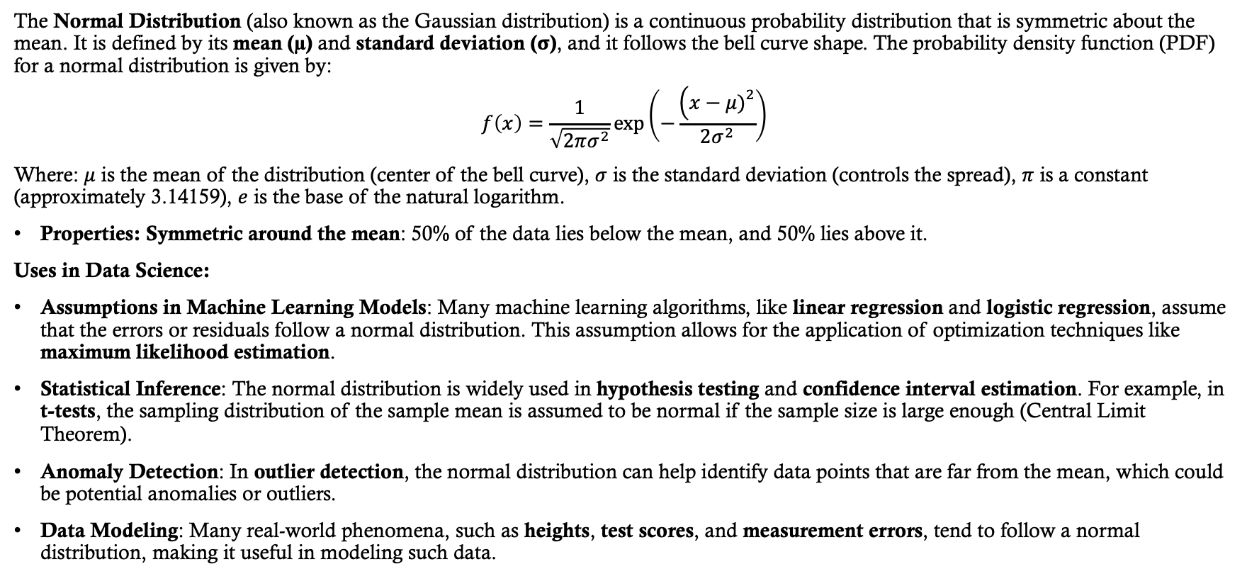
Normal Distribution
The Normal Distribution (also known as the Gaussian distribution) is a continuous probability distribution that is symmetric about the mean. It is defined by its mean (µ) and standard deviation (σ), and it follows the bell curve shape. The probability density function (PDF) for a normal distribution is given by:
$$f\left(x\right)=\frac{1}{\sqrt{2πσ^{2}}}\exp\left(−\frac{\left(x−μ{\left.)\right.}^{2}\right.}{2σ^{2}}\right)$$
Where: $μ$ is the mean of the distribution (center of the bell curve), $σ$ is the standard deviation (controls the spread), $π$ is a constant (approximately 3.14159), $e$ is the base of the natural logarithm.
Properties: Symmetric around the mean: 50% of the data lies below the mean, and 50% lies above it.
Uses in Data Science:
Assumptions in Machine Learning Models: Many machine learning algorithms, like linear regression and logistic regression, assume that the errors or residuals follow a normal distribution. This assumption allows for the application of optimization techniques like maximum likelihood estimation.
Statistical Inference: The normal distribution is widely used in hypothesis testing and confidence interval estimation. For example, in t-tests, the sampling distribution of the sample mean is assumed to be normal if the sample size is large enough (Central Limit Theorem).
Anomaly Detection: In outlier detection, the normal distribution can help identify data points that are far from the mean, which could be potential anomalies or outliers.
Data Modeling: Many real-world phenomena, such as heights, test scores, and measurement errors, tend to follow a normal distribution, making it useful in modeling such data.

Slide 30
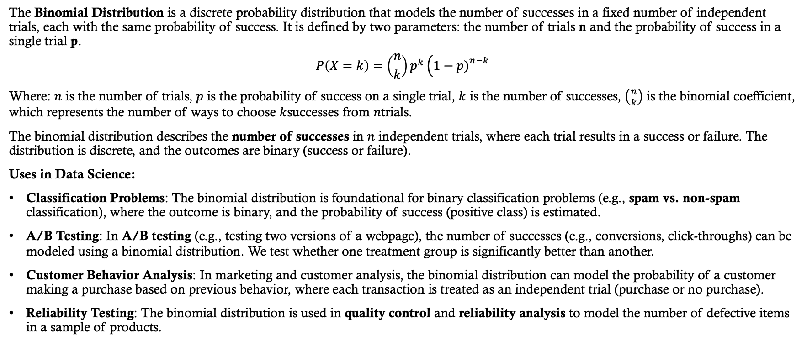
Binomial Distribution
The Binomial Distribution is a discrete probability distribution that models the number of successes in a fixed number of independent trials, each with the same probability of success. It is defined by two parameters: the number of trials n and the probability of success in a single trial p.
$$P\left(X=k\right)=\left({n \atop k}\right)p^{k}\left(1−p{\left.)\right.}^{n−k}\right.$$
Where: $n$ is the number of trials, $p$ is the probability of success on a single trial, $k$ is the number of successes, $\left({n \atop k}\right)$ is the binomial coefficient, which represents the number of ways to choose $k$successes from $n$trials.
The binomial distribution describes the number of successes in $n$ independent trials, where each trial results in a success or failure. The distribution is discrete, and the outcomes are binary (success or failure).
Uses in Data Science:
Classification Problems: The binomial distribution is foundational for binary classification problems (e.g., spam vs. non-spam classification), where the outcome is binary, and the probability of success (positive class) is estimated.
A/B Testing: In A/B testing (e.g., testing two versions of a webpage), the number of successes (e.g., conversions, click-throughs) can be modeled using a binomial distribution. We test whether one treatment group is significantly better than another.
Customer Behavior Analysis: In marketing and customer analysis, the binomial distribution can model the probability of a customer making a purchase based on previous behavior, where each transaction is treated as an independent trial (purchase or no purchase).
Reliability Testing: The binomial distribution is used in quality control and reliability analysis to model the number of defective items in a sample of products.

Slide 31
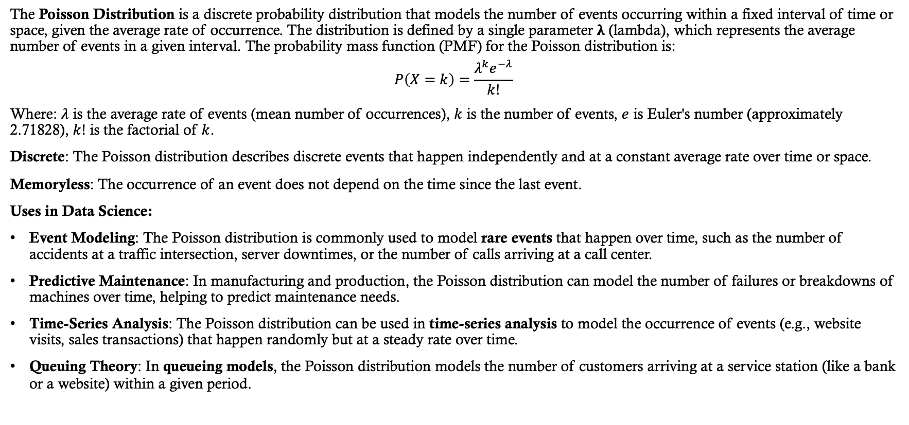
Poisson Distribution
The Poisson Distribution is a discrete probability distribution that models the number of events occurring within a fixed interval of time or space, given the average rate of occurrence. The distribution is defined by a single parameter λ (lambda), which represents the average number of events in a given interval. The probability mass function (PMF) for the Poisson distribution is:
$$P\left(X=k\right)=\frac{λ^{k}e^{−λ}}{k!}$$
Where: $λ$ is the average rate of events (mean number of occurrences), $k$ is the number of events, $e$ is Euler's number (approximately 2.71828), $k!$ is the factorial of $k$.
Discrete: The Poisson distribution describes discrete events that happen independently and at a constant average rate over time or space.
Memoryless: The occurrence of an event does not depend on the time since the last event.
Uses in Data Science:
Event Modeling: The Poisson distribution is commonly used to model rare events that happen over time, such as the number of accidents at a traffic intersection, server downtimes, or the number of calls arriving at a call center.
Predictive Maintenance: In manufacturing and production, the Poisson distribution can model the number of failures or breakdowns of machines over time, helping to predict maintenance needs.
Time-Series Analysis: The Poisson distribution can be used in time-series analysis to model the occurrence of events (e.g., website visits, sales transactions) that happen randomly but at a steady rate over time.
Queuing Theory: In queueing models, the Poisson distribution models the number of customers arriving at a service station (like a bank or a website) within a given period.

Slide 32
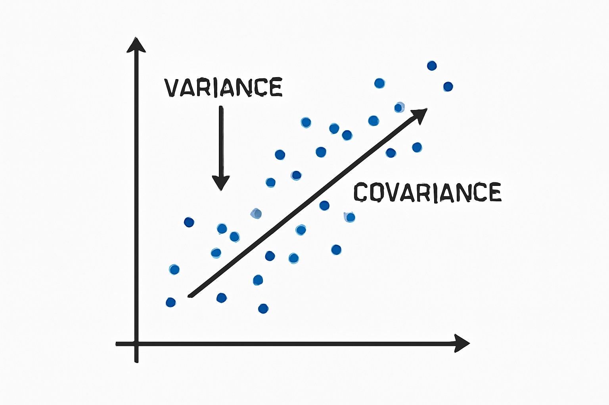
Expectation, Variance, and Covariance
In data science, Expectation, Variance, and Covariance are fundamental statistical concepts that help in understanding the behavior of data, making predictions, and building models. They are widely used in analyzing datasets, assessing relationships between variables, and optimizing machine learning algorithms.

Slide 33
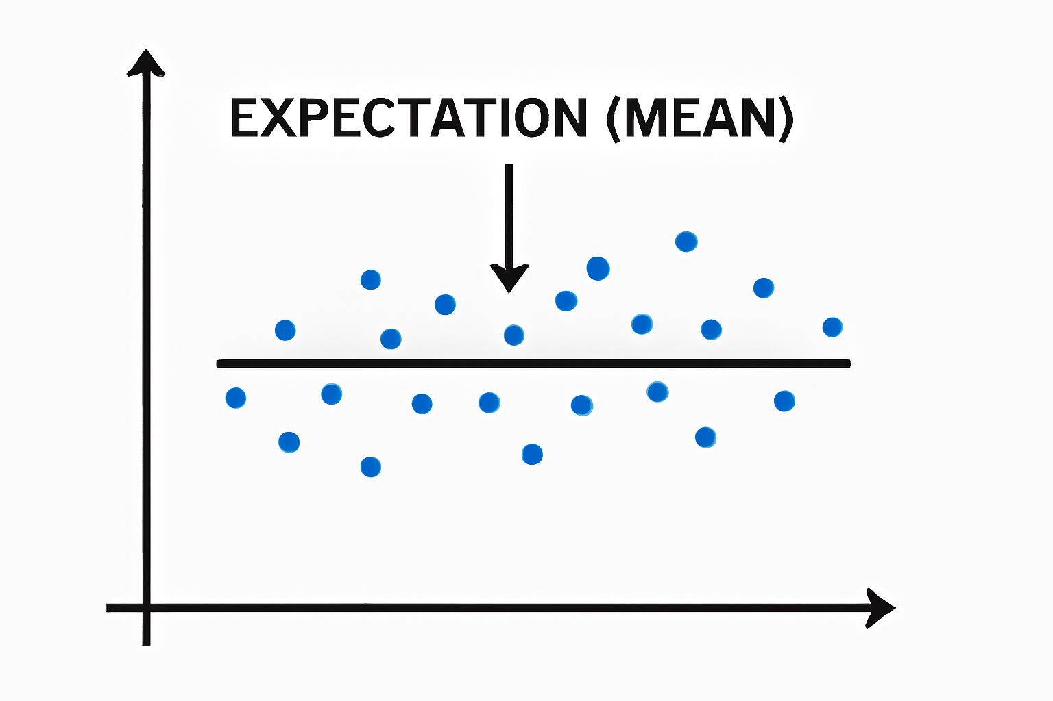
Expectation (Mean)
The expectation (or mean) of a random variable is the long-run average or the expected value of that variable. It provides a measure of the "central location" of a distribution and is used to summarize the distribution of a variable.
Uses in Data Science:
Central Tendency: The expectation represents the central tendency of a variable, helping to summarize data by finding its "average" value.
Loss Functions: In machine learning, expectation is used in defining loss functions. For example, the mean squared error (MSE) loss function calculates the expectation of the squared differences between predicted and true values.
Model Predictions: In probabilistic models, expectation is used to predict the expected output (e.g., the expected value of a future observation).
Risk Analysis: In financial modeling or risk analysis, the expectation is used to model the expected return of an investment or the expected cost in decision-making.

Slide 34
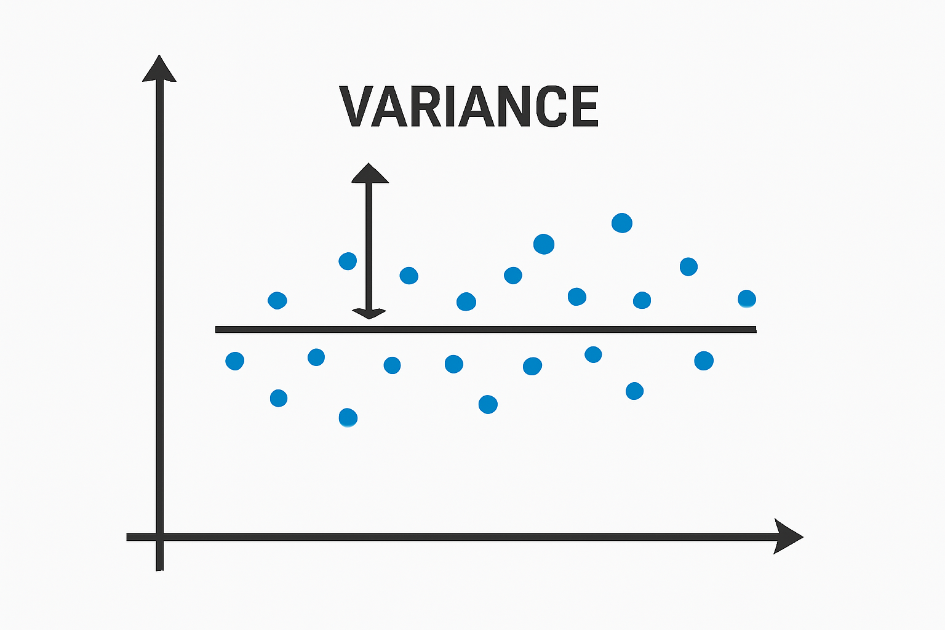
Variance
The variance of a random variable measures the spread or dispersion of the variable around its mean (expectation). A higher variance indicates that the data points are more spread out, while a lower variance indicates that the data points are closer to the mean.
Uses in Data Science:
Data Spread: Variance helps understand how spread out the data is. In machine learning, it can be used to detect the variability of features or outputs.
Model Evaluation: In regression, variance is used to assess how well the model fits the data. A high variance can indicate overfitting, while a low variance indicates underfitting.
Feature Selection: Variance is useful in feature selection: Features with very low variance provide little information and can be discarded, as they do not vary much across data points.
Risk Management: In finance and other fields, variance is used to quantify the risk of an investment. Higher variance indicates greater risk.

Slide 35
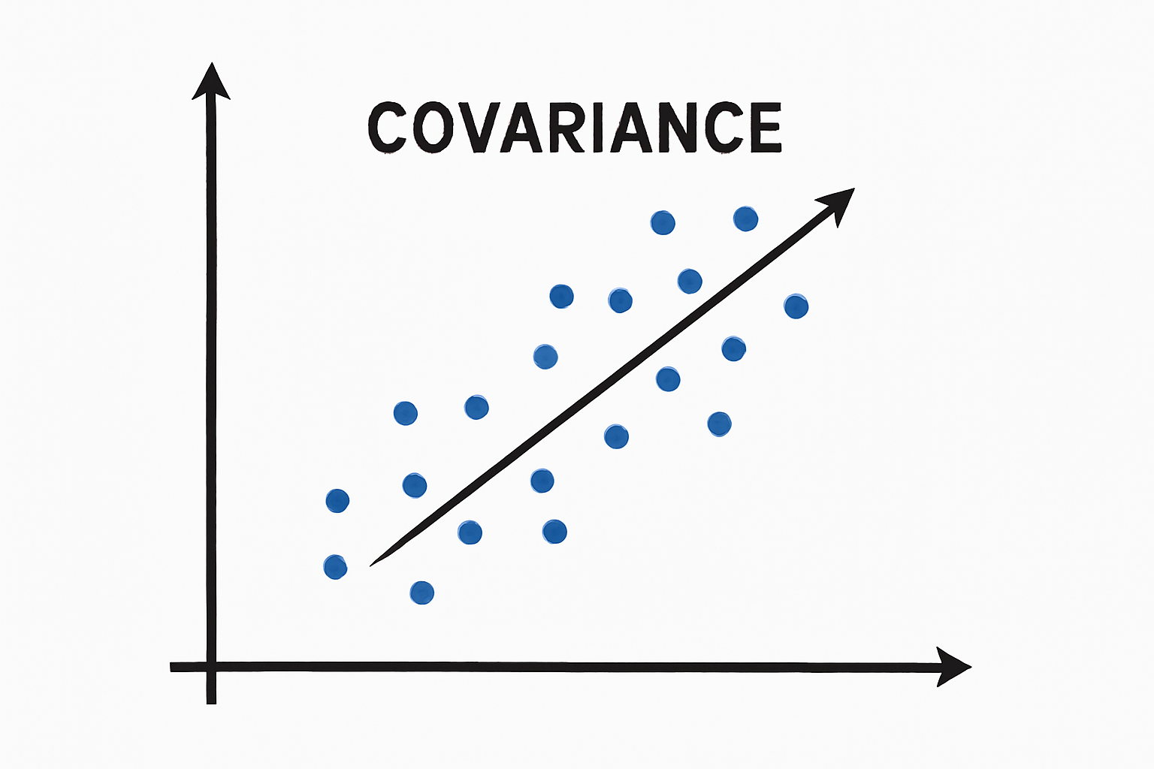
Covariance
Covariance measures the relationship between two random variables and indicates how much the variables change together. It can be positive (both variables increase or decrease together), negative (one increases as the other decreases), or zero (no relationship).
Uses in Data Science:
Feature Relationship: Covariance helps assess the relationship between two variables. If the covariance is positive, both variables tend to increase or decrease together, and if it’s negative, one increases while the other decreases.
Principal Component Analysis (PCA): In PCA, covariance is used to find the principal components (directions of maximum variance) of the data. A covariance matrix is created to understand how the variables interact.
Correlation: Covariance is related to correlation, which normalizes the covariance to a range between -1 and 1. It is often used to quantify the strength of the relationship between variables.
Portfolio Theory: In finance, covariance is used to measure how the returns of two assets move together. A positive covariance between assets suggests that the assets tend to move in the same direction, while a negative covariance indicates they move in opposite directions.

